Slide 1

Relational Database Management System
By
Krishnaprakash N

Slide 2
Introduction to Database
Data stored in file systems – problems with
  Redundancy
  Maintenance
  Security
  Efficient access to the data
Database Management Systems
A Database Management System (DBMS) is a software package designed to store and manage databases.

Slide 3
Capabilities of a Database Management System
Manage persistent data
Access large amounts of data efficiently
Support for certain high-level language that allow
the user to define the structure of the data, access
data, and manipulate data
Transaction management – the capability to provide correct,
concurrent access to the database by many users at once
Access control – the ability to limit access to data by
unauthorized users
Resiliency – the ability to recover from system
failures without losing data

Slide 5
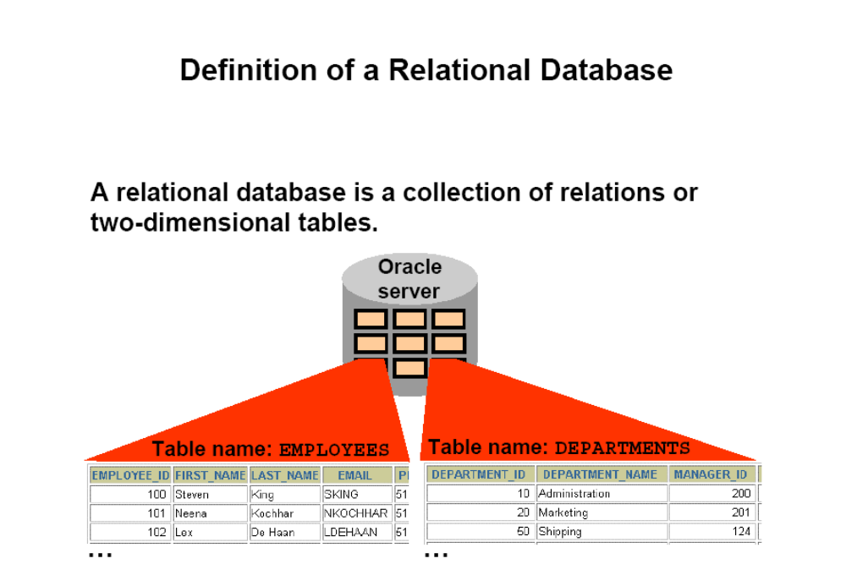

Slide 6
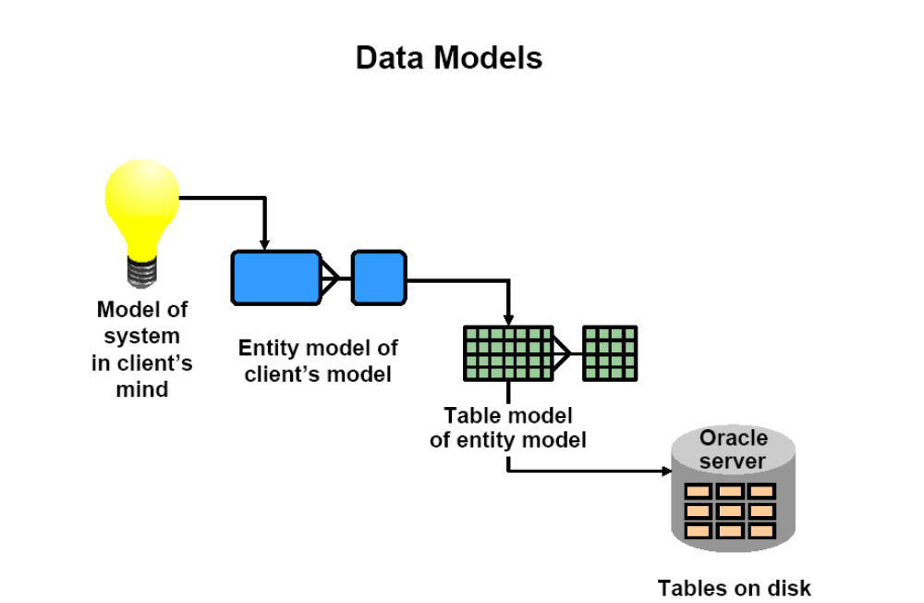

Slide 7
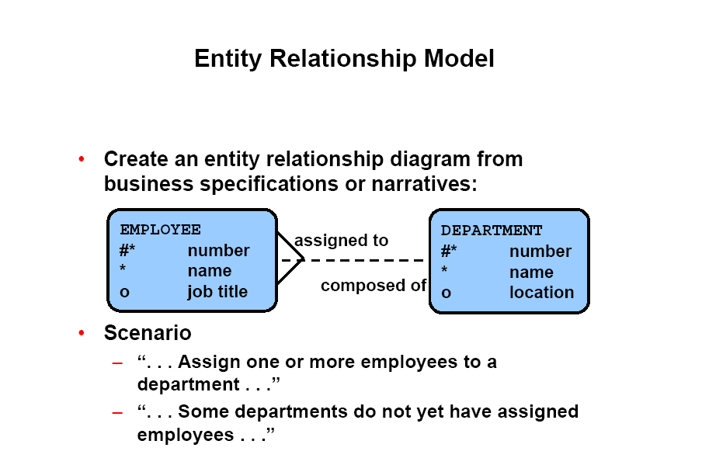

Slide 8
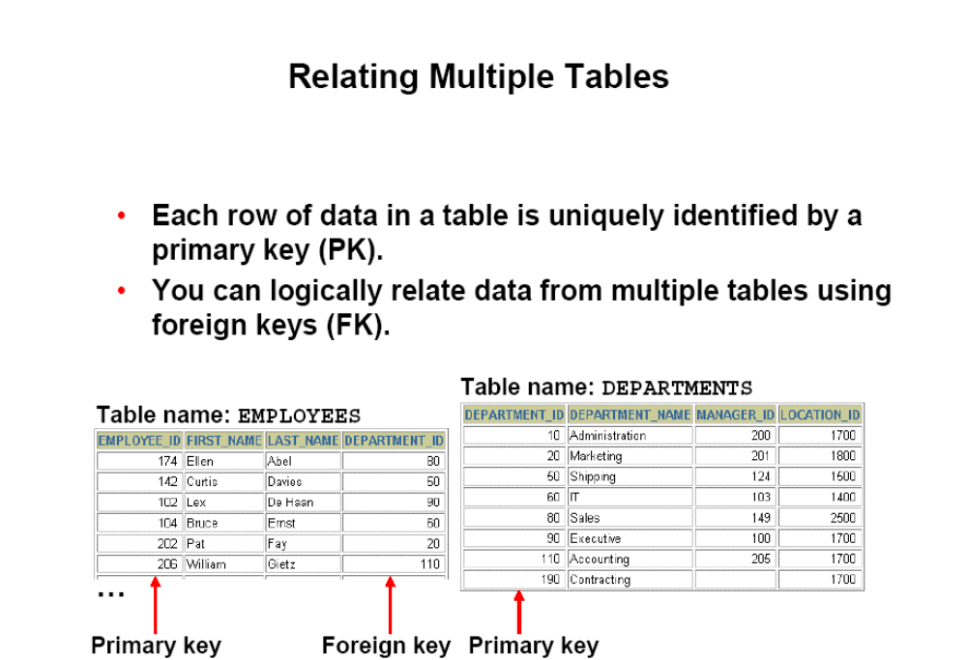

Slide 9
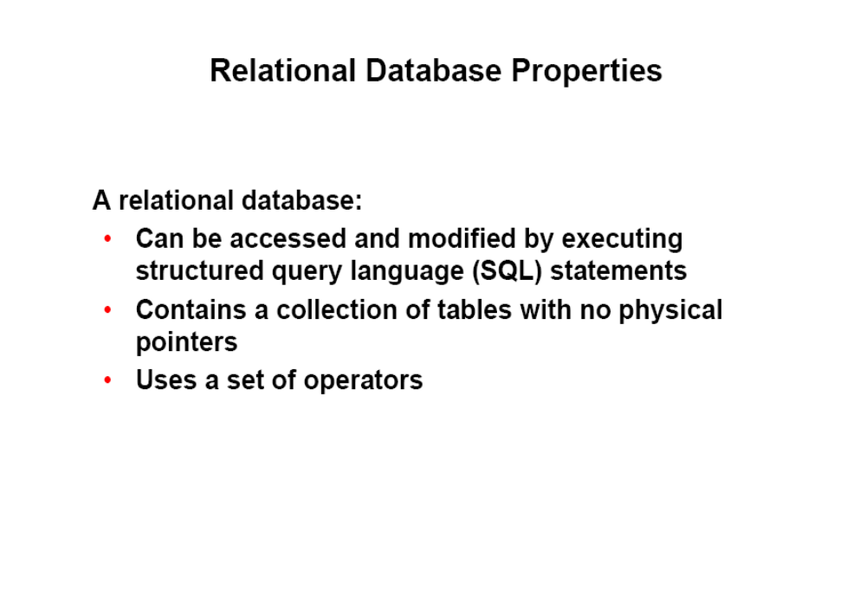

Slide 10
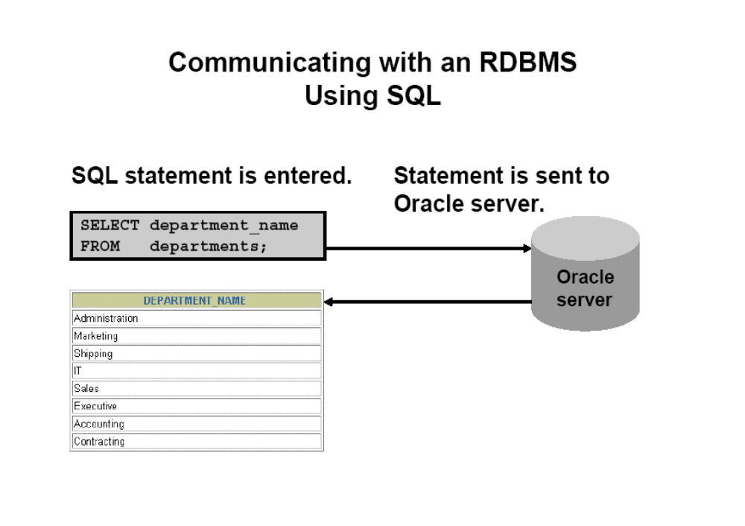

Slide 11
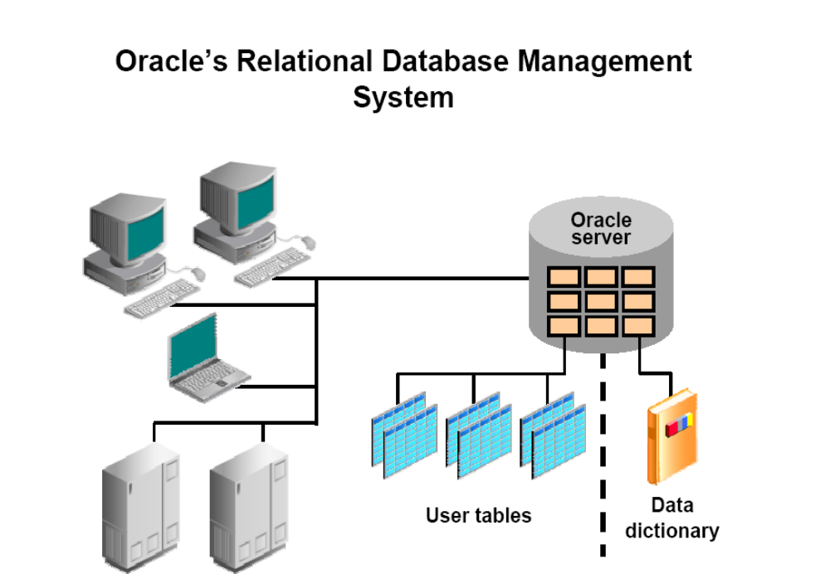

Slide 12
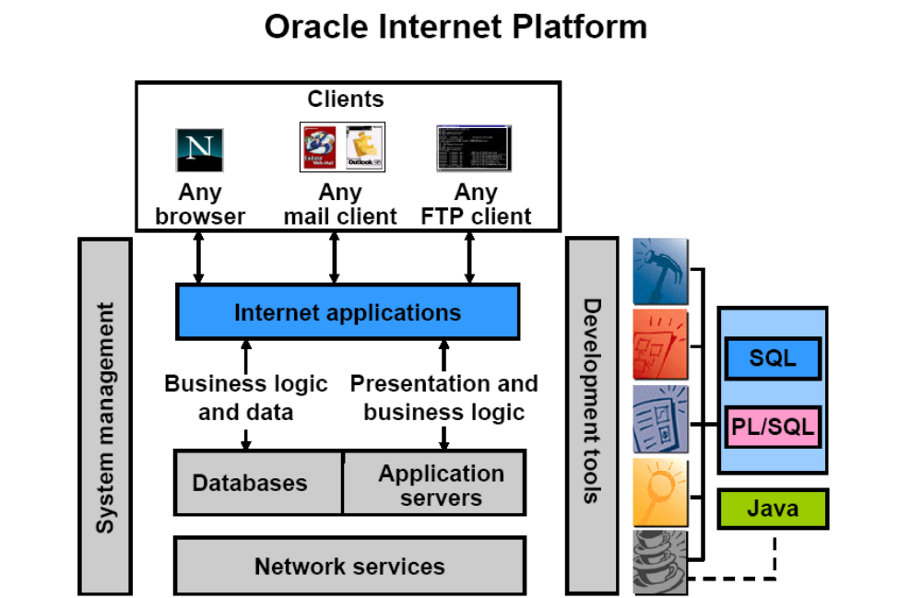

Slide 13
Object-Relational DBMS(ORDBMS)
ORDBMS, is a database that supports both relational
and object-oriented features.
Enhanced version of SQL (SQL-99)
ORDBMS - Features
  User-extensible types
  Encapsulation
  Inheritance
  Polymorphism
  Dynamic binding of methods

Slide 14
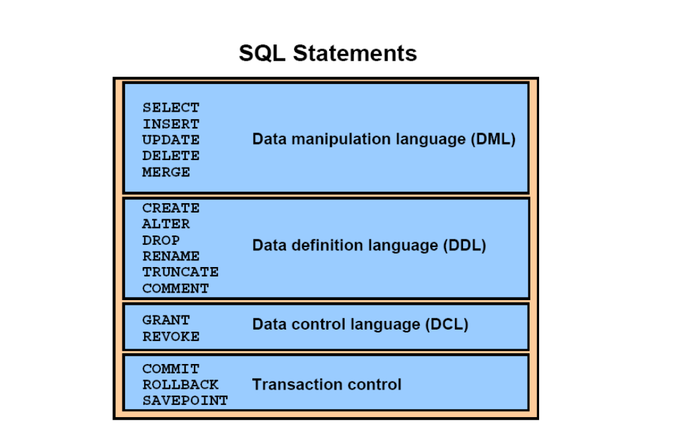

Slide 15
Writing Basic SQL SELECT statements

Slide 16
Capabilities of SQL SELECT Statements
A SELECT statement retrieves information from the database.
Using a SELECT statement, you can do the following:
Projection : You can use the projection capability in SQL to choose the columns in a table that you want returned by your query.
Selection : You can use the selection capability in SQL to choose the rows in a table that you want returned by a query. You can use various criteria to restrict the rows that you see.
Joining : You can use the join capability in SQL to bring together data that is stored in different tables by creating a link between them.

Slide 17
Writing SQL statements
SQL statements are not case sensitive.
SQL statements can be on one or more lines.
Keywords cannot be split across lines
Clauses are usually placed on separate lines
indents are used to enhance readability

Slide 18
Basic SELECT Statement
SELECT * |{[DISTINCT] column|expression [alias],...}
FROM table;
SELECT identifies what columns
FROM identifies which table

Slide 19
Defining a Null value
A null is a value that is unavailable, unassigned, unknown, or inapplicable.
A null is not the same as zero or a blank space.
If any column value in an arithmetic expression is null, the result is null.

Slide 20
Defining a Column Alias
Renames a column heading
Is useful with calculations
Immediately follows the column name : there can also be the optional AS keyword between the column name and alias.
Requires double quotation marks if it contains spaces or special characters
SELECT ename AS Name FROM emp;

Slide 21
Concatenation Operator
A Concatenation operator
Concatenates columns or character strings to other
columns
Is represented by two vertical bars (||)
Creates a resultant column that is a character expression
Using the Concatenation Operator
SELECT last_name||job_id AS "Employees" FROM employees;

Slide 22
Displaying Table Structure
You can display the structure of a table using the DESCRIBE command. The command shows the column names and data types, as well as whether a column must contain data.
DESCRIBE employees

Slide 23
Eliminating Duplicate Rows
Eliminate duplicate rows by using the DISTINCT keyword in the SELECT clause.
SELECT DISTINCT department_id
FROM employees;

Slide 24
Manipulating Data

Slide 25
Data Manipulation Language
A DML statement is executed when you:
  Add new rows to a table
  Modify existing rows in a table
  Remove existing rows from a table
A Transaction consists of a collection of DML statements
that form a logical unit of work.

Slide 26
Inserting New Rows
Insert a new row containing values for each column.
List values in the default order of the columns in the table
Optionally, list the columns in the INSERT clause.
INSERT INTO Departments
(department_id,department_name,manager_id,location_id)
VALUES (70,'Public Relations',100,1700);
Enclose character and date values within single quotation marks

Slide 27
Inserting Rows with Null Values
Implicit method : omit the column from the column list
INSERT INTO departments(department_id,department_name)
VALUES (30, 'Purchasing');
Explicit method : Specify the NULL keyword in the VALUES clause.
INSERT INTO departments VALUES (100,'Finance', NULL,NULL);

Slide 28
Updating Rows in a Table
Specific row or rows are modified if you specify the WHERE clause
  UPDATE employees
  SET department_id = 70
  WHERE employee_id = 113;
All rows in the table are modified if you omit thw WHERE clause.
  UPDATE employees
  SET department_id =110;

Slide 29
The DELETE statement
You can remove existing rows from a table by using the DELETE statement
  DELETE [FROM] table
  [WHERE condition];
  Specific rows are deleted if you specify the WHERE clause
  DELETE FROM departments
  WHERE department_name = 'Finance';
All rows in the table are deleted if you omit the WHERE clause.
  DELETE FROM employee;

Slide 30
The MERGE Statement
Provides the ability to conditionally update or insert data into a database table
Performs an UPDATE if the row exists and an INSERT if it is a new row
  Avoids separate updates
  Increases performance and ease of use
Merging Rows
  MERGE INTO copy_employees c
  USING employees e
  ON ( c.employee_id=e.employee_id )
  WHEN MATCHED THEN
  UPDATE SET
  ...
  WHEN NOT MATCHED THEN
  INSERT VALUES...;

Slide 31
Database Transactions
Begin when the first DML SQL statement is executed
End with one of the following events:
  A COMMIT or ROLLBACK statement is issued
  A DDL or DCL statement executes(Automatic Commit)
Advantages of COMMIT and ROLLBACK Statements
  Ensure data consistency
  Preview data changes before making changes permanent
  Group logically related operations

Slide 32
Transaction Control Statements
COMMIT
  Ends the current transaction by making all pending data changes permanent.
ROLLBACK
  Ends the current transaction by discarding all pending data changes.
SAVEPOINT
  Marks a savepoint within the current transaction

Slide 33
Creating and Managing Tables

Slide 34
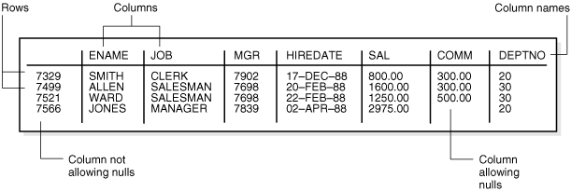
Overview of Tables
Tables are the basic unit of data storage in an Oracle
database. Data is stored in rows and columns
The EMP Table

Slide 35
The CREATE TABLE Statement
Each attribute of a relation (column in a table) in a RDBMS
has a datatype that defines the domain of values this
attribute can have
You Must have
- CREATE TABLE Privilege
- A storage area
Create table - describes the layout of the table by providing
  Table name
  Column names
  Datatype for each column
  Column size
  CREATE TABLE systems ( sys_id VARCHAR2(20),
sys_description VARCHAR2(100)
);

Slide 36
Data Types
Data Type | Description
Varchar2 | Variable-length character string. Maximum size is 4000 bytes or characters. You must specify size for VARCHAR2.
Char | Fixed-length character data of length size bytes. Maximum size is 2000 bytes or characters. Default and minimum size is 1 byte.
Number | Number having precision p and scale s. The precision p can range from 1 to 38. The scale s can range from -84 to 127.
Date | This datatype contains the datetime fields YEAR, MONTH, DAY, HOUR, MINUTE, and SECOND.
LONG | Character data of variable length up to 2 gigabytes.
CLOB | A character large object containing single-byte or multibyte characters.
BFILE | Contains a locator to a large binary file stored outside the database.
BLOB | A binary large object.

Slide 37
What are Constraints?
Constraints enforce rules at the table level
Constraints prevent the deletion of a table if there are
dependencies
The following constraint types are valid:
  - NOT NULL
  - UNIQUE
  - PRIMARY KEY
  - FOREIGN KEY
  - CHECK

Slide 38
Constraint Guidelines
Name a constraint or the Oracle Server generates a name by using the SYS Cn format
Create a constraint either:
  - At the same time as the table is created,or
  - After the table has been created.
Define a constraint at the column or table level
View a constraint in the data dictionary

Slide 39
The NOT NULL Constraint
The NOT NULL constraint ensures that the column contains no null values. Columns without the NOT NULL constraint can contain null values by default.
The NOT NULL constraint can be specified only at the column level, not at the table level.
Is defined at the column level
CREATE TABLE employee
( Employee_id NUMBER(6),
Last_name VARCHAR2(25) NOT NULL,
salary NUMBER(8,2),
commission_pct NUMBER(6,2),
hire_date DATE);

Slide 40
The UNIQUE Constraint
A UNIQUE Key integrity constraint requires that every value in a column or set of columns(key) be unique: that is , no two rows of a table can have duplicate values in a specified column or set of columns. The column(or set of columns) included in the definition of the UNIQUE key constraint is called the unique key.
UNIQUE constraints allow the input of nulls unless you also define NOT NULL constraints for the same columns
CREATE TABLE Department
  ( Deptno NUMBER(6),
  Dname VARCHAR2(10) UNIQUE);
  Note: The Oracle Server enforces the UNIQUE constraint by implicitly creating a unique index on the unique key column or columns.

Slide 41
The PRIMARY KEY Constraint
A PRIMARY KEY constraint creates a primary key for the table. Only one primary key can be created for a each table.
The PRIMARY KEY constraint is a column or set of columns that uniquely identifies each row in a table.
This constraint enforces uniqueness of the column or column combination and ensures that no column that is part of the primary key can contain a null value
CREATE TABLE Departments
(Deptno NUMBER(6),
Dname VARCHAR2(10),
CONSTRAINT dept_id_pk PRIMARY KEY(deptno));
Note : A UNIQUE index is created automatically for a PRIMARY KEY column.

Slide 42
The FOREIGN KEY Constraint
The FOREIGN KEY , or referential integrity constraint, designates a column combination of columns as a foreign key
and establishes a relationship between a primary key or a
unique key in the same table or a different table.
A FOREIGN KEY value must match an existing value in the
parent table or be NULL.
CREATE TABLE employees
( Employee_id NUMBER(6),
Last_name VARCHAR2(25),
salary NUMBER(8,2),
deptno Number(10),
CONSTRAINT emp_dept_fk FOREIGN KEY (deptno)
REFERENCES departments(deptno))

Slide 43
The CHECK Constraint
Define a condition that each row must satisfy
A single column can have multiple CHECK constraints which reference the column in its definition.There is no limit to the number of CHECK constraints which you can define on a column.
The following expressions are not allowed
  References to CURRVAL,NEXTVAl,LEVEL and ROW Pseudocolumns
  Queries that refer to other values in other rows
CREATE TABLE employee
(empno NUMBER(5),
Salary NUMBER(8,2)
CONSTRAINT emp_salary_min CHECK ( salary>0))

Slide 44
Adding a Constraint
Add a FOREIGN KEY constraint to the EMPLOYEES table to indicate that a manager must already exist as a valid
employee in the EMPLOYEES table.
ALTER TABLE employees
ADD CONSTRAINT emp_manager_fk
FOREIGN KEY(manager_id)
REFERENCES employees(employee_id);

Slide 45
Dropping a Constraint
Remove the manager constraint from the EMPLOYEES
table.
ALTER TABLE EMPLOYEES
DROP CONSTRAINT emp_manager_fk;
Remove the PRIMARY KEY constraint on the DEPARTMENTS table and drop the associated FOREIGN KEY constraint on the EMPLOYEES.DEPARTMENT_ID column.
ALTER TABLE departments
DROP PRIMARY KEY CASCADE;

Slide 46
Restricting and Sorting Data

Slide 47
Limiting Rows Using a Selection
Restrict the rows returned by using the WHERE clause.
  SELECT * |{[DISTINCT] column|expression[alias],...}
  FROM table
  [WHERE condition(s)];
The WHERE clause follows the FROM clause.

Slide 48
Character Strings and Dates
Character strings and date values are enclosed in single quotation marks.
Character values are case sensitive, and date values are format sensitive.
The default date format is DD-MM-RR
SELECT last_name, Job_id, Department_id
FROM employees
WHERE last_name='SMITH';

Slide 49
SQL Operators
Arithmetic Operators
Logical Operators
Set Operators
Comparison Operators

Slide 50
Set Operators
UNION
Combines queries to return all distinct rows
returned by ANY individual query.
INTERSECT
Combines queries to return all distinct rows
returned by EVERY individual query.
MINUS
Combines queries to return all distinct rows
returned by the FIRST query but not the second.

Slide 51
Comparison Conditions
BETWEEN... AND... Between two values
NOT BETWEEN... AND... Between two values
IN(set) Match any of a list of values
NOT IN(set) Match any of a list of values
LIKE Match a Character pattern
IS NULL - True if value is null
IS NOT NULL - True if not null
= , >= , < , <= and <>

Slide 52
Using the BETWEEN Condition
Use the BETWEEN condition to display rows based on a range of values.The range that you specify contains a lower limit and upper limit.
  SELECT last_name , salary
  FROM employees
  WHERE salary BETWEEN 2500 AND 3500;

Slide 53
Using the IN Condition
Use the IN membership condition to test for values in a list.
  SELECT employee_id, last_name , salary, manager_id
  FROM employees
  WHERE manager_id IN (100,101,666);
The IN condition can be used with any data types. If characters or dates are used in the list, they must be enclosed in single quotation marks('')

Slide 54
Using the LIKE condition
Use the LIKE condition to perform wildcard searches of valid search string values.
Search conditions can contain either literal characters or number:
  % denotes zero or many characters
  _ denotes one character
  SELECT first_name
  FROM employees
  WHERE first_name LIKE 'S%';
You can combine pattern-matching characters.
  SELECT last_name
  FROM employees
  WHERE last_name LIKE '_o%';

Slide 55
Using the NULL Conditions
Test for nulls with the IS NULL Operator
  SELECT last_name, manager_id
  FROM employees
  WHERE manager_id IS NULL;
The NULL conditions include the IS NULL condition and the IS NOT NULL condition.

Slide 56
ORDER BY Clause
Sort rows with the ORDER BY Clause
  ASC : ascending order (the default order)
  DESC: descending order
The ORDER BY Clause comes last in the SELECT statement.
  SELECT last_name,job_id,department_id,hire_date
  FROM employees
  ORDER BY hire_date;

Slide 57
Normalization & Joins

Slide 58
Objective
Write SELECT statements to access data from more than one table using equality and nonequality joins
View data that generally does not meet a join condition by using outer joins
Join a table to itself by using a self join

Slide 59
Why Normalize?
Flexibility
  Structure supports many ways to look at the data
Data Integrity
  Modification Anomalies
    Deletion
    Insertion
    Update
Efficiency
  Eliminate redundant data and save space

Slide 60
Normalization
Normalization is a process in database design which groups data into
various tables which are then cross linked by a particular field. In a
properly normalized database, there will be only one field in one table
for a particular piece of data, eliminating possibility for conflicts.
Breaking the database up into numerous smaller tables, and
eliminating redundancies, eases management and enhances efficiency.
First Normal Form(1NF)
Second Normal Form(2NF)
Third Normal Form(3NF)

Slide 61
Types Of Joins
Oracle Proprietary Joins(8i and prior)
  Equijoin
  Nonequijoin
  Outer Join
  Self Join
  Cartesian Products
SQL : 1999 Compliant joins
  Cross joins
  Natural joins
  Using clause
  Full or two sided outer joins
  Arbitrary join conditions for outer joins

Slide 62
Defining Joins
A join is a query that combines rows from two or more tables, views, or materialized views. Oracle Database performs a join whenever multiple tables appear in the FROM clause of the query. The select list of the query can select any columns from any of these tables. If any two of these tables have a column name in common, then you must qualify all references to these columns throughout the query with table names to avoid ambiguity.
Guidelines
  When writing a SELECT statement that joins tables, precede the column name with the table name for clarity and to enhance database access.
  If the same column name appears in more than one table, the
  column name must be prefixed with the table name.
  To join n tables together, you need a minimum of n-1 join
  conditions.

Slide 63
Joining Tables Using Oracle Syntax
Use a join to query data from more than one table.
  SELECT table1.column,table2.column
  FROM table1, table2
  WHERE table1.column1 = table2.column2;
Write the join condition in the WHERE clause.
Prefix the column name with the table name when the same column name appears in more than one table.

Slide 64
Cartesian Products
A Cartesian product is formed when:
  A join condition is omitted
  A join condition is invalid
  All rows in the first table are joined to all rows in the second table
To avoid a Cartesian product, always include a valid join condition in a WHERE clause.
  SELECT last_name,department_name dept_name
  FROM employees, departments;

Slide 65
Qualifying Ambiguous Column Names
Use table prefixes to qualify column names that are in multiple tables.
Improve performance by using table prefixes.
Distinguish columns that have identical names but reside in different tables by using column aliases
Using Table Aliases
  Simplify queries by using table aliases
  Improve performance by using table prefixes
  SELECT e.employee_id, e.last_name, e.department_id,
  d.department_id, d.location_id
  FROM employees e, departments d
  WHERE e.department_id =d.department_id;

Slide 66
Equijoins
An equijoin is a join with a join condition containing an equality operator. An equijoin combines rows that have equivalent values for the specified columns.
SELECT last_name, job_id, departments.department_id,department_name
FROM employees, departments
WHERE employees.department_id = departments.department_id
ORDER BY last_name;.

Slide 67
Self Join
A self join is a join of a table to itself. This table appears twice in the FROM clause and is followed by table aliases that qualify column names in the join condition. To perform a self join, Oracle Database combines and returns rows of the table that satisfy the join condition.
SELECT e1.last_name||' works for '||e2.last_name
"Employees and Their Managers“
FROM employees e1, employees e2
WHERE e1.manager_id = e2.employee_id
AND e1.last_name LIKE 'R%';\
Employees and Their Managers
----------------------------------------------
  Rajs works for Mourgos
  Raphaely works for King
  Rogers works for Kaufling
  Russell works for King

Slide 68
Outer Joins Syntax
You use an outer join to also see rows that do not meet the join condition.
The outer join operator is the plus sign(+)
  SELECT table1.column,table2.column,
  FROM table1, table2
  WHERE table1.column(+)=table2.column;
  SELECT table1.column,table2.column,
  FROM table1, table2
  WHERE table1.column=table2.column(+);

Slide 69
Creating Cross Joins
The CROSS JOIN Clause produces the cross product of two tables.
This is the same as a Cartesian product between the two tables.
  SELECT last_name, department_name
  FROM employees
  CROSS JOIN departments;

Slide 70
Creating Natural Joins
The NATURAL JOIN clause is based on all columns in the two tables that have the same name.
It selects rows from the two tables that have equal values in all matched columns.
If the columns having the same names have different data types, then an error is returned.
  SELECT department_id, department_name, location_id, city
  FROM departments
  NATURAL JOIN locations;

Slide 71
Creating Joins with the USING Clause
If several columns have the same names but the data types do not match, the NATURAL JOIN clause can be modified with the USING clause to specify the columns that should be used for an equijoin.
Do not use a table name or alias in the referenced columns
  select e.employee_id,e.last_name,d.location_id
  FROM employees e JOIN departments d
  USING(department_id)

Slide 72
Creating Joins with the ON Clause
The join condition for the natural join is basically an equijoin of all columns with tha same name
To specify arbitrary conditions or specify columns to join, the ON clause is used.
Separates the join condition from other search conditions
The ON clause makes code easy to understand.
  select e.employee_id, e.last_name, e.department_id, d.department_id, d.location_id
  FROM employees e JOIN departments d
  ON (e.department_id=d.department_id)

Slide 73
INNER versus OUTER Joins
In SQL : 1999 , the join of two tables returning only matched rows is an inner join.
A join between two tables that returns the results of an inner join as well as the unmatched rows left(or right) tables is a left(or right) outer join.
A join between two tables that returns the results of an inner join as well as the results of a left and right join is a full outer join.

Slide 74
LEFT OUTER JOIN
Example of LEFT OUTER JOIN
This query retrieves all rows in the EMPLOYEES table, Which is the left table even if there is no match in the DEPARTMENTS table.
  SELECT e.last_name, e.department_id, d.department_name
  FROM employees e
  LEFT OUTER JOIN departments d
  ON (e.department_id=d.department_id);
This query was completed in earlier releases as follows.
  SELECT e.last_name, e.department_id, d.department_name
  FROM employees e , departments d
  WHERE d.department_id(+) = e.department_id

Slide 75
RIGHT OUTER JOIN
Example of RIGHT OUTER JOIN
This query retrieves all rows in the DEPARTMENTS table,
Which is the right table even if there is no match in the
EMPLOYEES table.
SELECT e.last_name, e.department_id, d.department_name
FROM employees e
RIGHT OUTER JOIN departments d
ON (e.department_id=d.department_id);
This query was completed in earlier releases as follows
SELECT e.last_name, e.department_id, d.department_name
FROM employees e , departments d
WHERE d.department_id=e.department_id(+);

Slide 76
FULL OUTER JOIN
This query retrieves all rows in the EMPLOYEES table, even if there is no match in the DEPARTMENTS table. It also retrieves all rows in the DEPARTMENTS table, even if there is no match in the EMPLOYEES table
  SELECT e.last_name, e.department_id, d.department_name
  FROM employees e
  FULL OUTER JOIN departments d
  ON (e.department_id=d.department_id);

Slide 77
Normalization & Joins

Slide 78
Objective
Write SELECT statements to access data from more than one table using equality and nonequality joins
View data that generally does not meet a join condition by using outer joins
Join a table to itself by using a self join

Slide 79
Why Normalize?
Flexibility
  Structure supports many ways to look at the data
Data Integrity
  Modification Anomalies
    Deletion
    Insertion
    Update
Efficiency
  Eliminate redundant data and save space

Slide 80
Normalization
Normalization is a process in database design which groups data into
various tables which are then cross linked by a particular field. In a
properly normalized database, there will be only one field in one table
for a particular piece of data, eliminating possibility for conflicts.
Breaking the database up into numerous smaller tables, and
eliminating redundancies, eases management and enhances efficiency.
First Normal Form(1NF)
Second Normal Form(2NF)
Third Normal Form(3NF)

Slide 81
Types Of Joins
Oracle Proprietary Joins(8i and prior)
  Equijoin
  Nonequijoin
  Outer Join
  Self Join
  Cartesian Products
SQL : 1999 Compliant joins
  Cross joins
  Natural joins
  Using clause
  Full or two sided outer joins
  Arbitrary join conditions for outer joins

Slide 82
Defining Joins
A join is a query that combines rows from two or more tables, views, or materialized views. Oracle Database performs a join whenever multiple tables appear in the FROM clause of the query. The select list of the query can select any columns from any of these tables. If any two of these tables have a column name in common, then you must qualify all references to these columns throughout the query with table names to avoid ambiguity.
Guidelines
  When writing a SELECT statement that joins tables, precede the column name with the table name for clarity and to enhance database access.
  If the same column name appears in more than one table, the
  column name must be prefixed with the table name.
  To join n tables together, you need a minimum of n-1 join
  conditions.

Slide 83
Joining Tables Using Oracle Syntax
Use a join to query data from more than one table.
  SELECT table1.column,table2.column
  FROM table1, table2
  WHERE table1.column1 = table2.column2;
Write the join condition in the WHERE clause.
Prefix the column name with the table name when the same column name appears in more than one table.

Slide 84
Cartesian Products
A Cartesian product is formed when:
  A join condition is omitted
  A join condition is invalid
  All rows in the first table are joined to all rows in the second table
To avoid a Cartesian product, always include a valid join condition in a WHERE clause.
  SELECT last_name,department_name dept_name
  FROM employees, departments;

Slide 85
Qualifying Ambiguous Column Names
Use table prefixes to qualify column names that are in multiple tables.
Improve performance by using table prefixes.
Distinguish columns that have identical names but reside in different tables by using column aliases
Using Table Aliases
  Simplify queries by using table aliases
  Improve performance by using table prefixes
  SELECT e.employee_id, e.last_name, e.department_id,
  d.department_id, d.location_id
  FROM employees e, departments d
  WHERE e.department_id =d.department_id;

Slide 86
Equijoins
An equijoin is a join with a join condition containing an equality operator. An equijoin combines rows that have equivalent values for the specified columns.
SELECT last_name, job_id, departments.department_id,department_name
FROM employees, departments
WHERE employees.department_id = departments.department_id
ORDER BY last_name;.

Slide 87
Self Join
A self join is a join of a table to itself. This table appears twice in the FROM clause and is followed by table aliases that qualify column names in the join condition. To perform a self join, Oracle Database combines and returns rows of the table that satisfy the join condition.
SELECT e1.last_name||' works for '||e2.last_name
"Employees and Their Managers“
FROM employees e1, employees e2
WHERE e1.manager_id = e2.employee_id
AND e1.last_name LIKE 'R%';\
Employees and Their Managers
----------------------------------------------
  Rajs works for Mourgos
  Raphaely works for King
  Rogers works for Kaufling
  Russell works for King

Slide 88
Outer Joins Syntax
You use an outer join to also see rows that do not meet the join condition.
The outer join operator is the plus sign(+)
  SELECT table1.column,table2.column,
  FROM table1, table2
  WHERE table1.column(+)=table2.column;
  SELECT table1.column,table2.column,
  FROM table1, table2
  WHERE table1.column=table2.column(+);

Slide 89
Creating Cross Joins
The CROSS JOIN Clause produces the cross product of two tables.
This is the same as a Cartesian product between the two tables.
  SELECT last_name, department_name
  FROM employees
  CROSS JOIN departments;

Slide 90
Creating Natural Joins
The NATURAL JOIN clause is based on all columns in the two tables that have the same name.
It selects rows from the two tables that have equal values in all matched columns.
If the columns having the same names have different data types, then an error is returned.
  SELECT department_id, department_name, location_id, city
  FROM departments
  NATURAL JOIN locations;

Slide 91
Creating Joins with the USING Clause
If several columns have the same names but the data types do not match, the NATURAL JOIN clause can be modified with the USING clause to specify the columns that should be used for an equijoin.
Do not use a table name or alias in the referenced columns
  select e.employee_id,e.last_name,d.location_id
  FROM employees e JOIN departments d
  USING(department_id)

Slide 92
Creating Joins with the ON Clause
The join condition for the natural join is basically an equijoin of all columns with tha same name
To specify arbitrary conditions or specify columns to join, the ON clause is used.
Separates the join condition from other search conditions
The ON clause makes code easy to understand.
  select e.employee_id, e.last_name, e.department_id, d.department_id, d.location_id
  FROM employees e JOIN departments d
  ON (e.department_id=d.department_id)

Slide 93
INNER versus OUTER Joins
In SQL : 1999 , the join of two tables returning only matched rows is an inner join.
A join between two tables that returns the results of an inner join as well as the unmatched rows left(or right) tables is a left(or right) outer join.
A join between two tables that returns the results of an inner join as well as the results of a left and right join is a full outer join.

Slide 94
LEFT OUTER JOIN
Example of LEFT OUTER JOIN
This query retrieves all rows in the EMPLOYEES table, Which is the left table even if there is no match in the DEPARTMENTS table.
  SELECT e.last_name, e.department_id, d.department_name
  FROM employees e
  LEFT OUTER JOIN departments d
  ON (e.department_id=d.department_id);
This query was completed in earlier releases as follows.
  SELECT e.last_name, e.department_id, d.department_name
  FROM employees e , departments d
  WHERE d.department_id(+) = e.department_id

Slide 95
RIGHT OUTER JOIN
Example of RIGHT OUTER JOIN
This query retrieves all rows in the DEPARTMENTS table,
Which is the right table even if there is no match in the
EMPLOYEES table.
SELECT e.last_name, e.department_id, d.department_name
FROM employees e
RIGHT OUTER JOIN departments d
ON (e.department_id=d.department_id);
This query was completed in earlier releases as follows
SELECT e.last_name, e.department_id, d.department_name
FROM employees e , departments d
WHERE d.department_id=e.department_id(+);

Slide 96
FULL OUTER JOIN
This query retrieves all rows in the EMPLOYEES table, even if there is no match in the DEPARTMENTS table. It also retrieves all rows in the DEPARTMENTS table, even if there is no match in the EMPLOYEES table
  SELECT e.last_name, e.department_id, d.department_name
  FROM employees e
  FULL OUTER JOIN departments d
  ON (e.department_id=d.department_id);

Slide 97
Aggregating Data Using Group Functions

Slide 98
What are Group Functions?
Group functions operate on sets of rows to give one result per group.
Group Functions Syntax
  SELECT [column,] group_function(column), ...
  FROM table
  [WHERE condition]
  [GROUP BY column]
  [ORDER BY column];
Guidelines for Using Group Functions
  The Data types for the functions with an expr argument may be CHAR, VARCHAR2,NUMBER, or DATE
  All group functions ignore null values. To substitute a value for null values, use the NVL, NVL2,or COALESCE.
  The Oracle Server implicitly sorts the result set in ascending order when using a GROUP BY Clause. To override the default ordering, DESC can be used in an ORDER BY Clause.

Slide 99
Types Of Group Functions
AVG - Average value of n, ignoring null values.
COUNT - Number of rows, where expr evaluates to something other than null (count all selected rows using *, including duplicates and rows with nulls)
MAX - Maximum value of expr, ignoring null values
MIN - Minimum value of expr, ignoring null values
SUM - Sum values of n, ignoring null values.

Slide 100
The COUNT Function
The COUNT function has three formats
  COUNT(*)
  COUNT(expr)
  COUNT(DISTINCT expr)
COUNT(*) returns the number of rows in a table that satisfy the criteria of the SELECT statement, including duplicate rows and rows containing null values in any of the columns.
COUNT( expr) returns the number of rows with non-null values for the expr.
Display the number of department values in the EMPLOYEES table, excluding the null values.
  SELECT COUNT( commission_pct)
  FROM employees
  WHERE department_id = 80;

Slide 101
Using the MIN and MAX Functions
You can use MIN and MAX for any data type.
The example displays the most junior and most senior employee.
SELECT MIN(hire_date), MAX(hire_date)
FROM employees;

Slide 102
Using the AVG and SUM Functions
You can use AVG and SUM for numeric data.
The example displays the average and sum of the salaries
for all employees.
  SELECT AVG(salary), SUM(salary)
  FROM employees

Slide 103
The GROUP BY Clause
You can use the GROUP BY clause to divide the rows in a table into groups. You can then use the group functions to return summary information for each group.
Guidelines
  If you include a group function in a SELECT clause, You cannot select individual results as well , unless the individual column appears in the GROUP BY clause.
  Using a WHERE clause, you can exclude rows before dividing then into groups.
  You must include the columns in the GROUP BY clause.
  You cannot use a column alias in the GROUP BY clause.
  By default, rows are sorted by ascending order of the columns included in the GROUP BY list. You can override this by using the ORDER BY clause.

Slide 104
Excluding Group Results: The HAVING Clause
The HAVING Clause
  You use the HAVING clause to specify which groups are to be displayed.
The Oracle Server performs the following steps when you use the HAVING clause:
  Rows are Grouped.
  The group function is applied to the Group
  The groups that match the criteria in the HAVING clause are displayed
  SELECT department_id, MAX(salary)
  FROM employees
  GROUP BY department_id
  HAVING MAX(salary)>10000;

Slide 105
Subqueries

Slide 106
Subqueries
A subquery is a SELECT statement that is embedded in a clause of another SELECT statement.
You can place the subquery in a number of SQL clauses:
  The WHERE clause
  The HAVING clause
  The FROM Clause
The subquery generally executes first and its output is used to complete the query condition for the main or outer query.

Slide 107
Subquery syntax
The subquery(inner query) executes once before the main query.
The result of the subquery is used by the main query(outer query).
SELECT select_list
FROM table
WHERE expr operator
(SELECT select_list FROM table);
Example:
Select last_name FROM employees
WHERE salary >
(SELECT salary FROM employees
WHERE last_name = 'SCOTT');

Slide 108
Guidelines for using subqueries
Enclose subqueries in parentheses.
Place subqueries on the right side of the comparison condition.
The ORDER BY clause in the subquery is not needed unless you are performing top-n analysis.
Use single-row operators with single-row subquries and use multiple-row operators with multiple-row subqueries.
Two classes of comparison conditions are used in subqueries: single-row operators and multi-row operators

Slide 109
Types of subqueries
Single-row subquery
  Queries that return only one row from the inner SELECT statement
    SELECT last_name,job_id FROM employees
    WHERE job_id=
    (SELECT job_id FROM employees
    WHERE employee_id=666);
Multiple-row subquery
  Queries that return more than one row from the inner SELECT statement
    SELECT last_name,salary,department_id
    FROM employees
    WHERE salary in (SELECT MIN(salary) FROM employees
    GROUP BY department_id);

Slide 110
The HAVING Clause with Subqueries
The Oracle Server executes subqueries first
The Oracle server returns results into the HAVING clause of the main query.
  SELECT department_id, MIN(salary)
  FROM employees
  GROUP BY department_id
  HAVING MIN(salary) >
  (SELECT MIN(salary) FROM employees
  WHERE department_id=50)

Slide 111
Multiple-Row Subqueries
Return more than one row
Use multiple-row comparison operators
Operator | Meaning
IN | Equal to any member in the list
ANY | Compare value to each value returned by the subquery
ALL | Compare value to every value returned by the subquery

Slide 112
Using the ANY and ALL operator in Multiple-ROW Subqueries
Using the ANY operator in Multiple-ROW Subqueries
  SELECT employee_id, last_name, job_id, salary
  FROM employees
  WHERE salary <ANY
  (SELECT salary FROM employees
  WHERE job_id='IT_PROG');
Using the ALL operator in Multiple-ROW Subqueries
  SELECT employee_id, last_name, job_id, salary
  FROM employees
  WHERE salary <ALL
  (SELECT salary FROM employees
  WHERE job_id='IT_PROG');

Slide 113
Copying Rows from Another table
Write your INSERT statement with a subquery
  INSERT INTO employee_backup (employee_id,last_name,salary)
  SELECT employee_id,last_name,salary
  FROM employee
  WHERE job_id LIKE '%REP%';
Do not use the VALUES clause
Match the number of columns in the INSERT clause to those in the subquery.

Slide 114
Using a Subquery in the FROM Clause
A subquery in the FROM clause of a SELECT statement is also called an inline view. A subquery in the FROM clause of a SELECT statement defines a data source for that particular SELECT statement.
  SELECT a.last_name,a.salary,a.department_id,b.sal_avg
  FROM employees a , (SELECT department_id, AVG(salary) sal_avg
  FROM employees
  GROUP BY department_id) b
  WHERE a.department_id = b.department_id AND a.salary > b.sal_avg;

Slide 115
Creating Views

Slide 116
Database Objects
Object | Description
Table | Basic unit of storage; composed of rows and columns
View | Logically represents subsets of data from one or more tables
Sequence | Generates primary key values
Index | Improves the performance of some queries

Slide 117
What is a view?
A view is a logical table based on a table or another view. A view contains no data of its own but is like a window through which data from tables can be viewed or changed.
  CREATE [OR REPLACE] [FORCE|NOFORCE] VIEW view
  AS subquery
  [WITH CHECK OPTION [CONSTRAINT constraint]]
  [WITH READ ONLY [CONSTRAINT constraint]];

Slide 118
Why Use Views
To restrict data access
To make complex queries easy
To provide data independence
To present different views of the same data

Slide 119
Simple Views versus Complex Views
There are two classifications for views : simple and complex.
A simple view is one that:
  Derives data from only one table
  Contains no functions or groups of data
  Can perform DML operations through the view
A complex view is one that;
  Derives data from many tables
  Contains functions or groups of data
  Does not always allow DML operations through the view

Slide 120
Creating a View
Create a view by using column aliases in the subquery.
  CREATE VIEW emp_view
  AS SELECT employee_id EMPNO, last_name NAME, salary*12 ANN_SALARY
  FROM employees
  WHERE department_id=50;
Select the columns from this view by the given alias names.

Slide 121
Creating a complex view
Create a complex view that contains group functions to display values from two tables.
  CREATE VIEW dept_sum_view
  (name,minsal,maxsal,avgsal)
  AS SELECT d.department_name, MIN( e.salary ),
  MAX(e.salary), AVG(e.salary)
  FROM employees e, departments d
  WHERE e.department_id = d.department_id
  GROUP BY d.department_name;

Slide 122
Rules for performing
DML Operations on a view
You can perform DML operations on simple views.
You cannot remove a row if the view contains the following
  Group functions
  A GROUP BY clause
  The DISTINCT keyword
  The pseudocolumn ROWNUM keyword

Slide 123
Using the WITH CHECK OPTION Clause
You can ensure that DML operations performed on the view stay within the domain of the view by using the WITH CHECK OPTION clause.
  CREATE OR REPLACE VIEW emp_view
  AS SELECT *
  FROM employees
  WHERE department_id = 20
  WITH CHECK OPTION CONSTRAINT empview20_ck;
Any attempt to change the department number for any row
in the view fails because it violates the WITH CHECK OPTION
constraint.

Slide 124
Denying DML Operations
You can ensure that no DML operations occur by adding the WITH READ ONLY option to your view definition.
Any attempt to perform a DML on any row in the view results in an oracle server error.
  CREATE OR REPLACE VIEW empview
  (employee_number, employee_name, job_title)
  AS SELECT employee_id, last_name, job_id
  FROM employees
  WHERE department_id = 10
  WITH READ ONLY;

Slide 125
What is a Sequence?
A sequence:
  Automatically generates unique numbers
  Is a sharable object
  Is typically used to create a primary key value
  Replaces application code
  Speeds up the efficiency of accessing sequence values when cached in memory

Slide 126
The CREATE SEQUENCE Statement Syntax
Define a sequence to generate sequential numbers automatically.
  CREATE SEQUENCE sequence
  [INCREMENT BY n]
  [START WITH n]
  [{MAXVALUE n | NOMAXVALUE}]
  [{MINVALUE n | NOMINVALUE}]
  [{CYCLE | NOCYCLE}]
  [{CACHE n | NOCACHE}];

Slide 127
Creating a Sequence
Create a sequence named DEPT_DEPTID_SEQ to be used for the primary key of the DEPARTMENTS table
Do not use the CYCLE option
  CREATE SEQUENCE dept_deptid_seq
  INCREMENT BY 10
  START WITH 120
  MAXVALUE 9999
  NOCACHE
  NOCYCLE;

Slide 128
NEXTVAL and CURRVAL Pseudocolumns
NEXTVAL returns the next available sequence value.
  it returns a unique value every time it is referenced, even for
  different users.
CURRVAL obtains the current sequence value.
NEXTVAL must be issued for that sequence before CURRVAL contains a value.

Slide 129
Using a Sequence
Insert a new department named " Support" .
  INSERT INTO departments(department_id,
  department_name)
  VALUES (dept_deptid_seq.NEXTVAL, 'Support');
View the current value for the DEPT_DEPTID_SEQ sequence
  SELECT dept_deptid_seq.CURRVAL
  FROM dual;

Slide 130
Synonym
A synonym is an alternative name for a table, view,sequence, procedure, stored function, package, snapshot, or another synonym.
Ease referring to a table owned by another user
Shorten lengthy object names
  CREATE [PUBLIC] SYNONYM synonym
  FOR object;

Slide 131
Creating and Removing Synonyms
Create a shortened name for the DEPT table.
  CREATE SYNONYM dt
  FOR dept;
Drop a synonym
  DROP SYNONYM dt;

Slide 132
Index
An index is a database object that contains an entry for each value that appears in the index column(s) of the table or cluster and provides direct, fast access to rows.
  CREATE [UNIQUE] INDEX ind_name
  ON [table (column)];
Example:
CREATE INDEX emp_ind
ON emp(empno);

Slide 133
Controlling User Access

Slide 134
Privileges
Database security
  System security
  Data security
System Privileges
  Gaining access to the database
Object Privileges
  Manipulation the content of the database objects.
Schemas
  Collections of objects, such as tables, views, and sequences.

Slide 135
System Privileges
Once a user is created , the DBA can grant specific system privileges to a user.
An application developer, for example, may have the following system privileges:
  CREATE SESSION
  CREATE TABLE
  CREATE SEQUENCE
  CREATE VIEW
  CREATE PROCEDURE

Slide 136
Object Privileges
Object privileges vary from object to object
An owner has all the privileges on the object
An owner can give specific privileges on that owner's object.
Grant query privileges on the EMPLOYEES table\
GRANT select,update,delete,insert ON employees to SAPE;
Grant privileges to update specific columns to users and roles.
GRANT update (department_name, location_id)
ON departments
TO scott;

Slide 137
Oracle Data Dictionary
Each Oracle database has a data dictionary. An Oracle data dictionary is a set of tables and views that are used as a read-only reference about the database. For example, a data dictionary stores information about both the logical and physical structure of the database. A data dictionary also stores the following information:
The valid users of an Oracle database
Information about integrity constraints defined for tables in the database
The amount of space allocated for a schema object and how much of it is in use

Slide 138
Oracle Architecture

Slide 139
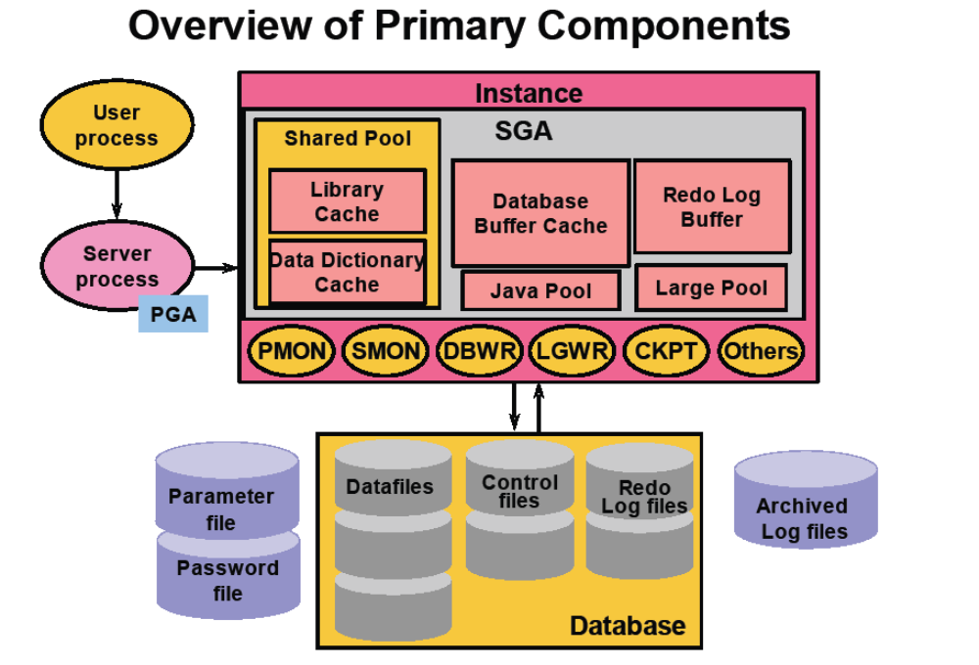

Slide 142
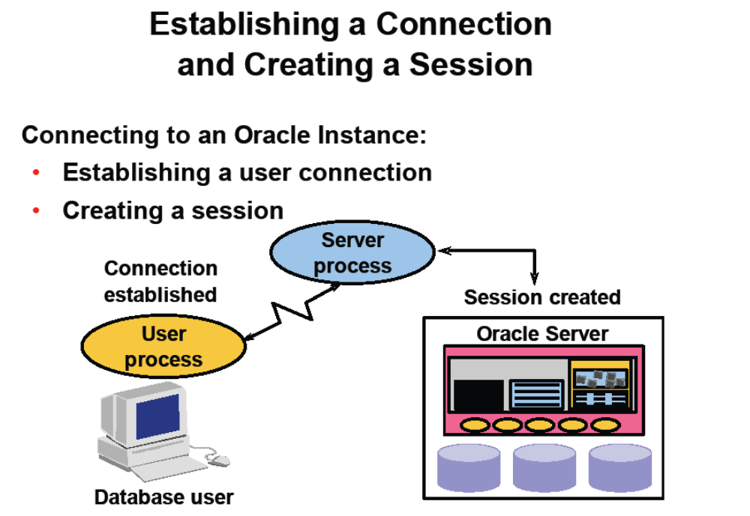

Slide 143
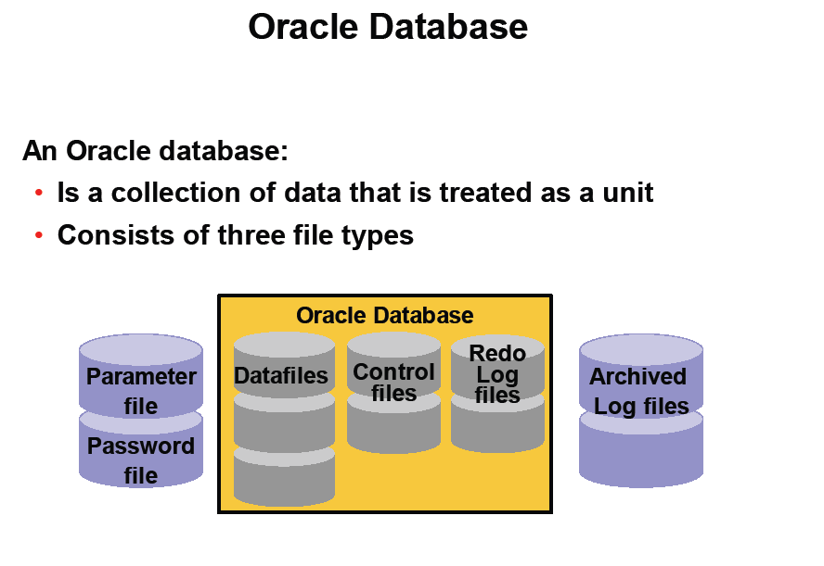

Slide 144
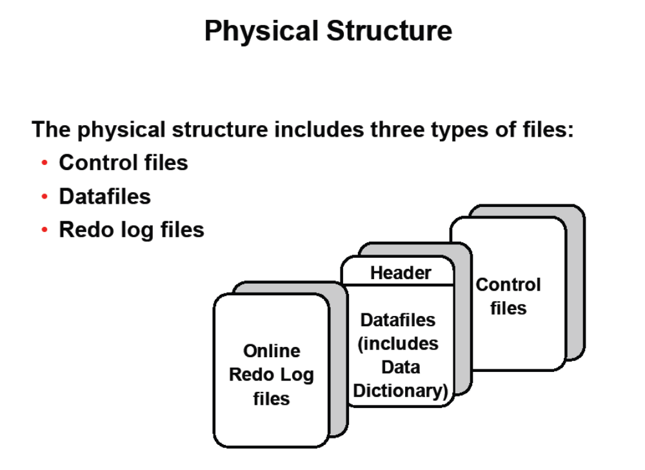

Slide 145
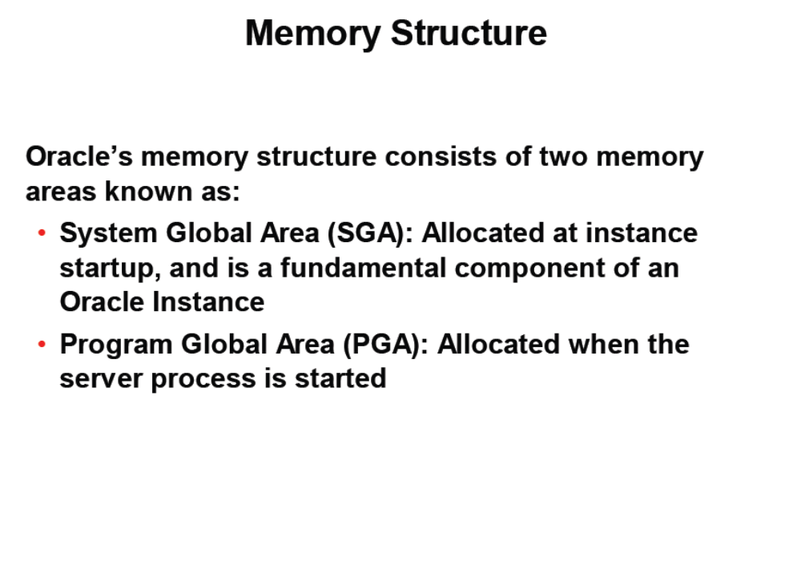

Slide 146
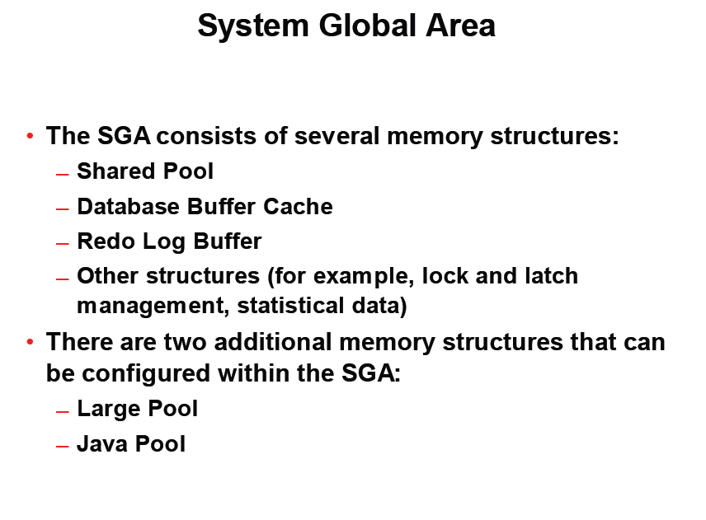

Slide 147
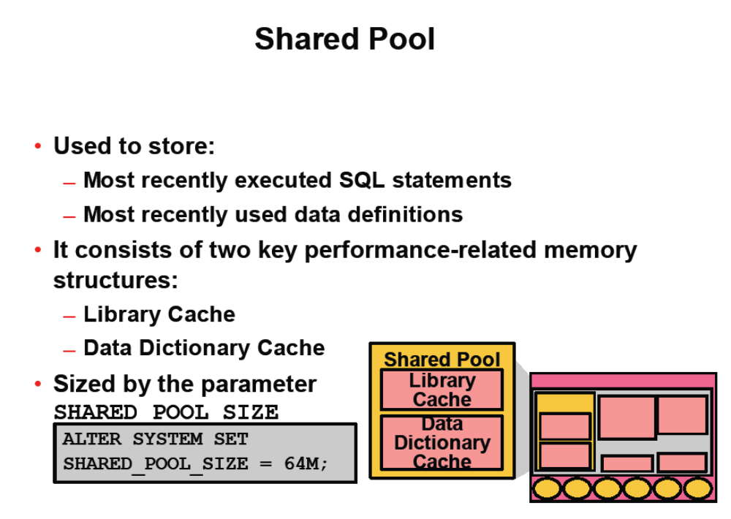

Slide 148
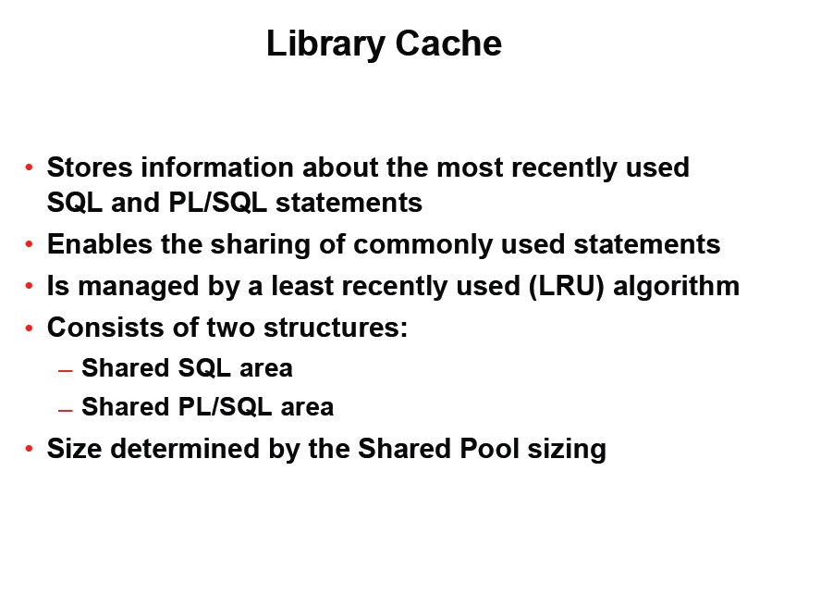

Slide 149
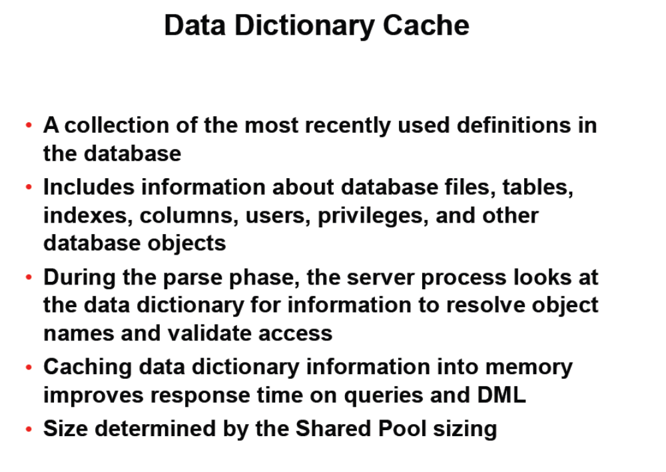

Slide 150
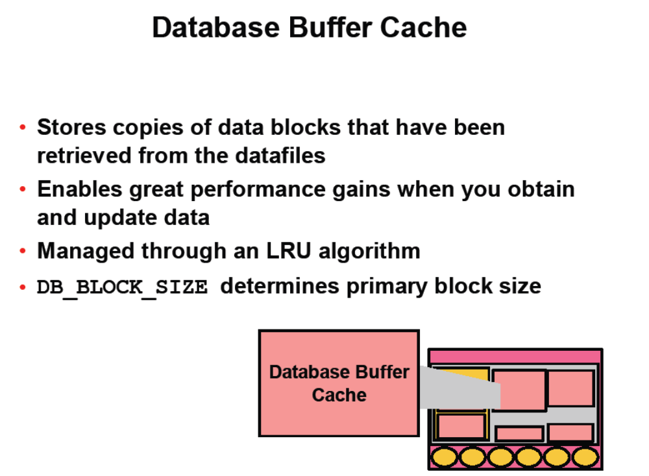

Slide 151
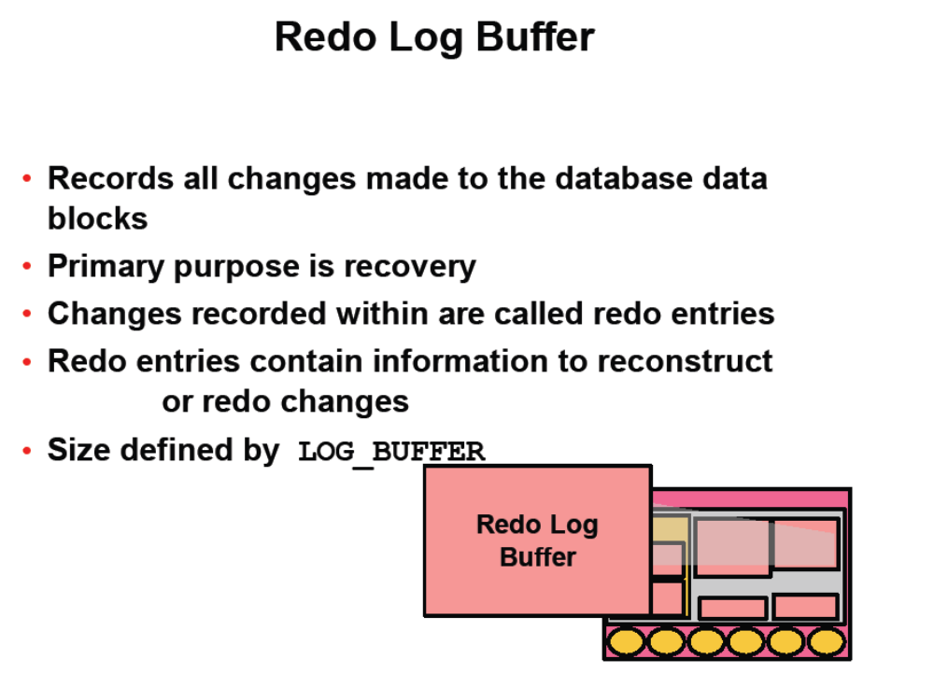

Slide 152
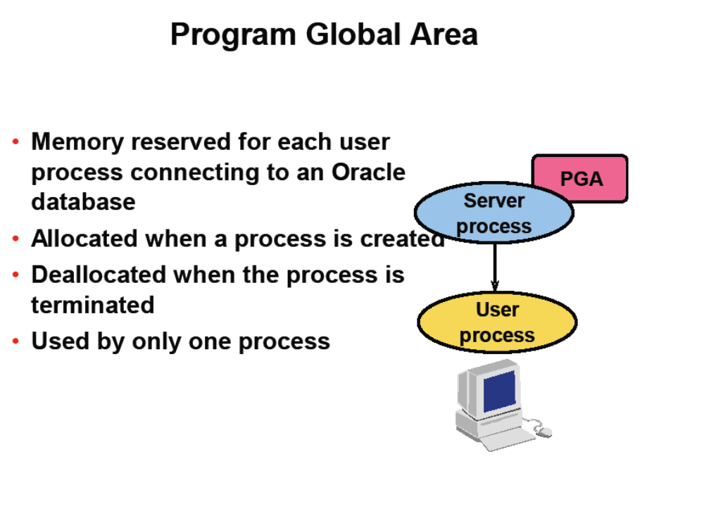

Slide 153
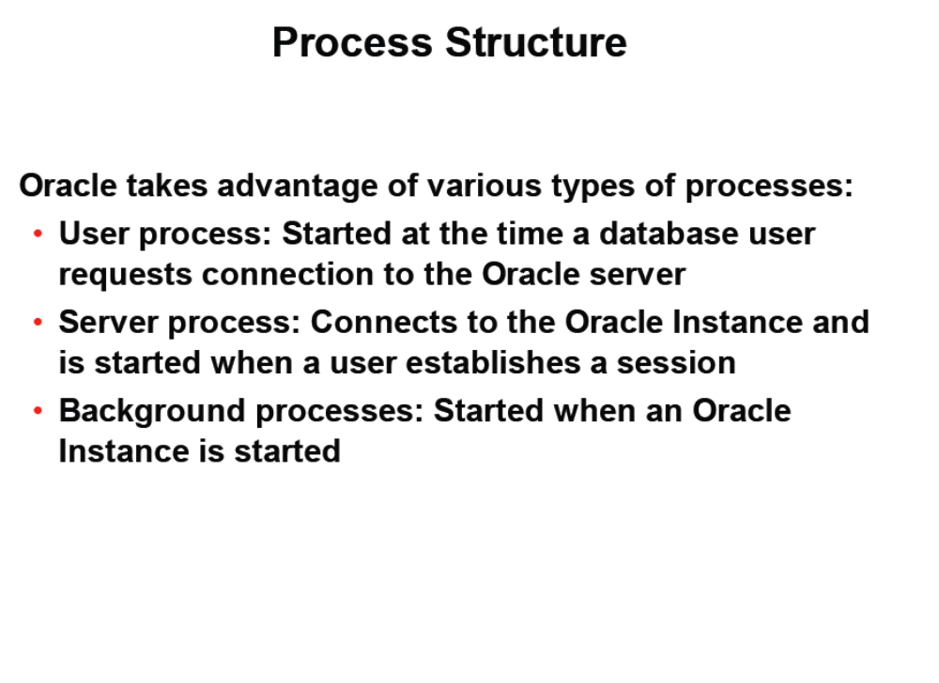

Slide 154
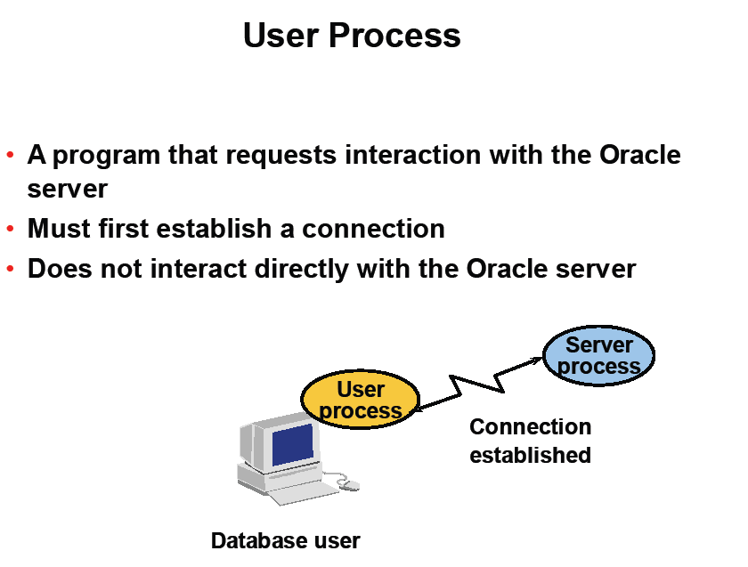

Slide 155
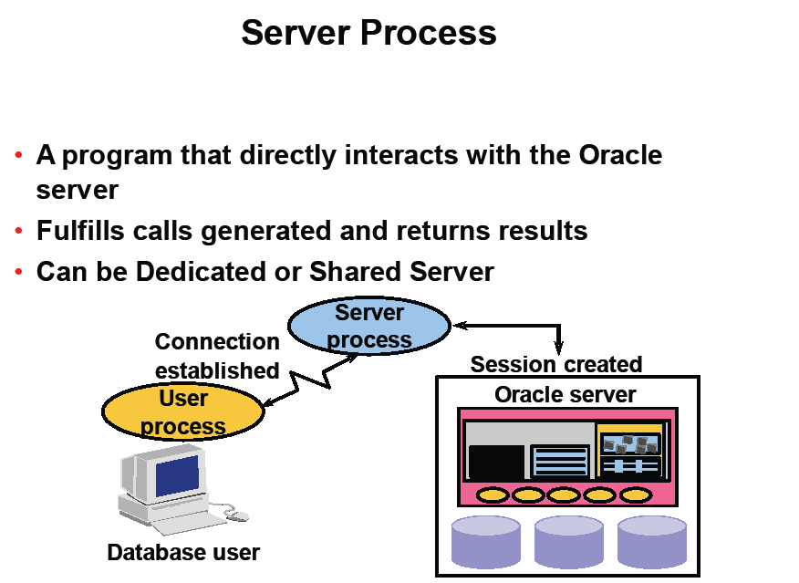

Slide 156
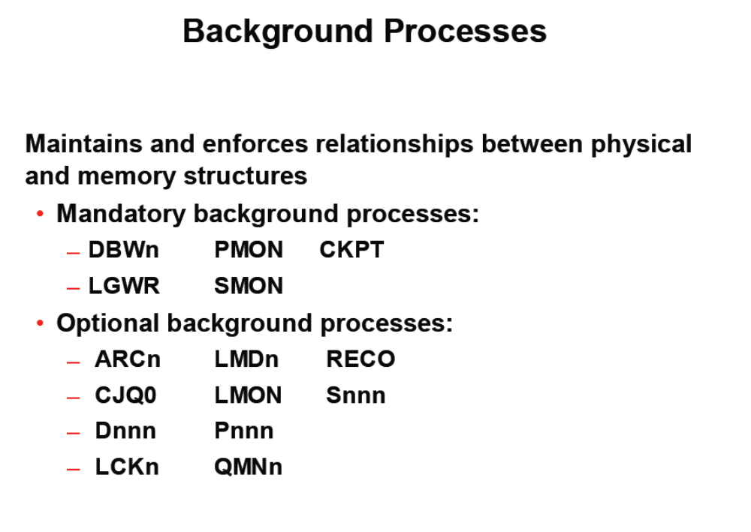

Slide 157
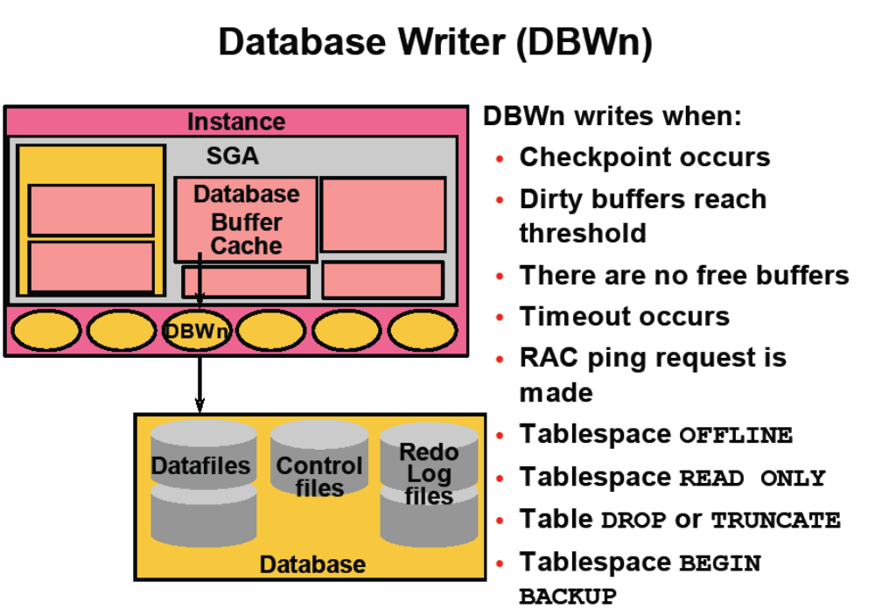

Slide 159
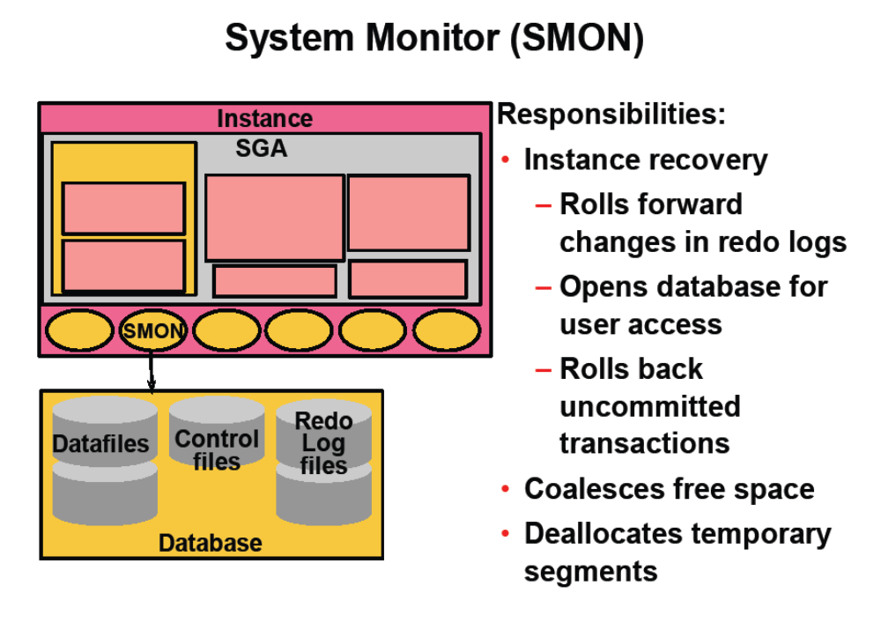

Slide 160
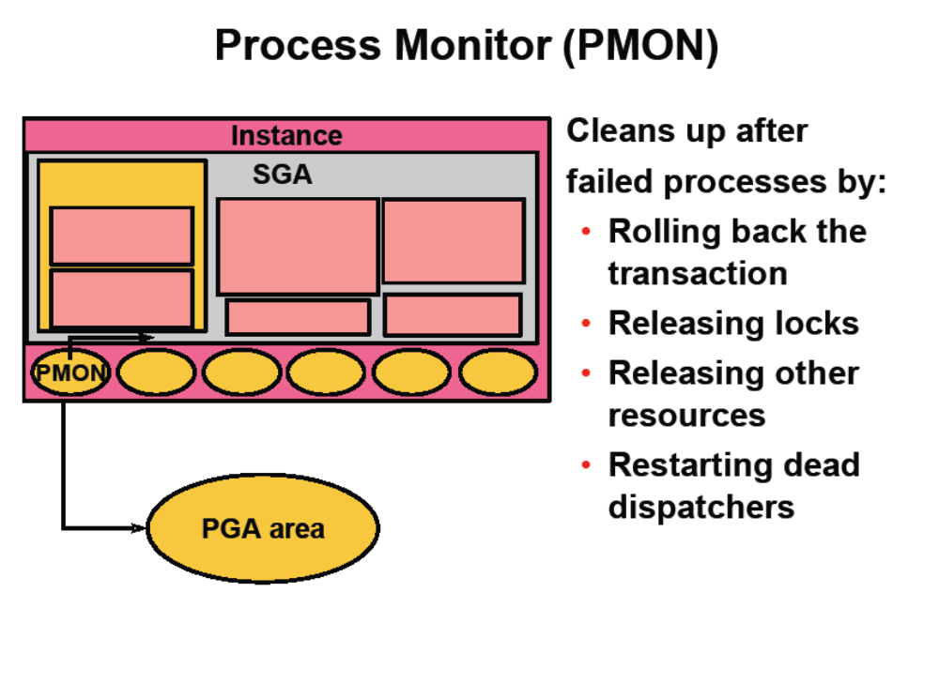

Slide 161
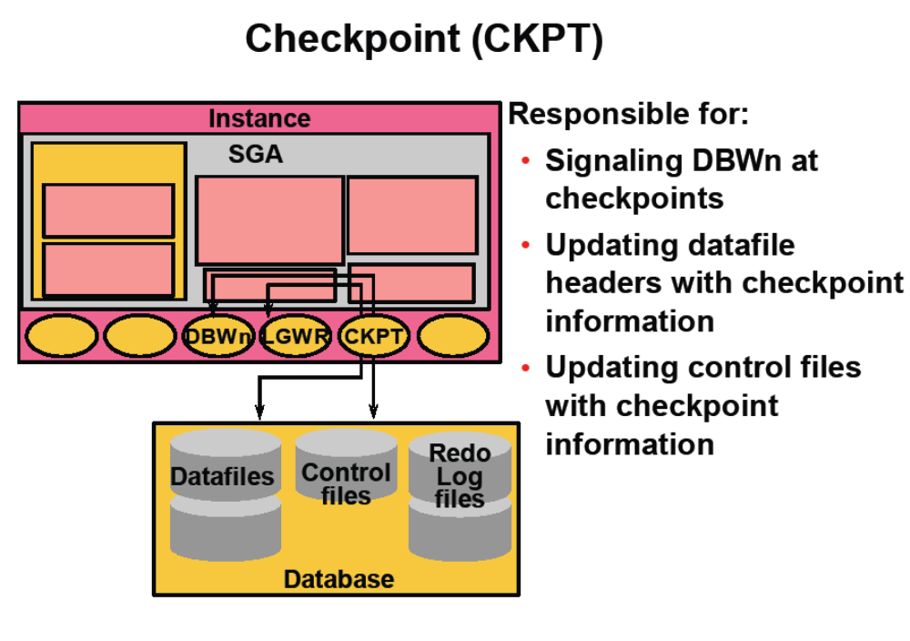

Slide 162
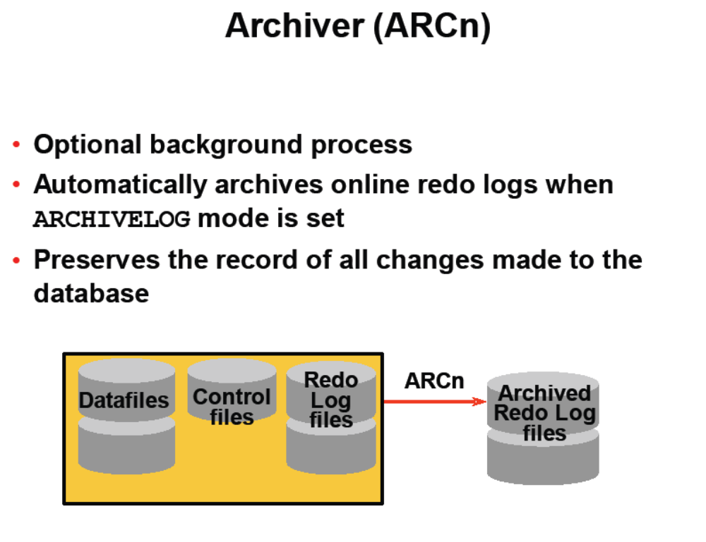

Slide 163
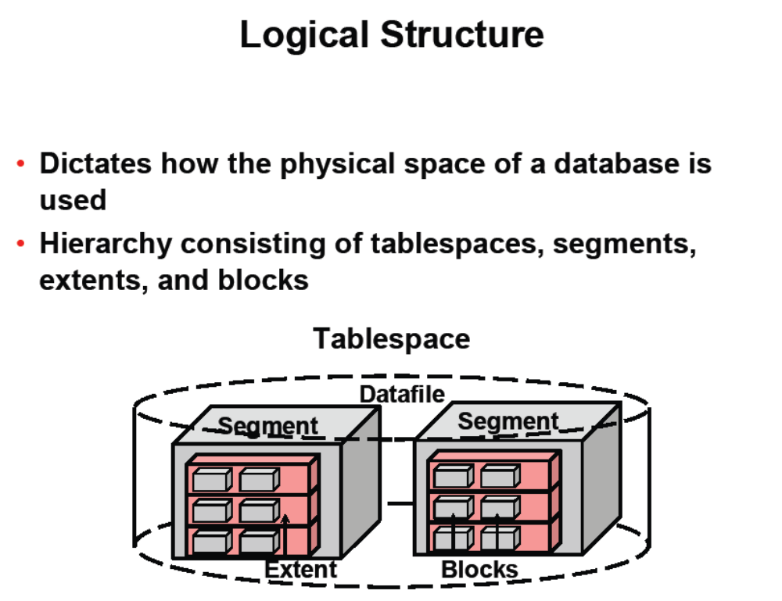

Slide 164
